Slide 1

Academic Session 2026-27
ODD Semester July-Dec 2026
UNIVERSITY INSTITUTE OF ENGINEERING AND TECHNOLOGY
Department of TT
Bachelor of Engineering (B.E.) – CSE
Advanced Data Structures / Semester 3
(CS221)
Unit No. 1 Chapter No. 1.1 Lecture No. 7
Topic : Binary Search and Complexity Analysis
Abhishek Thakur (E19789) Technical Trainer
Sourav Jaiswal (E19756)-MSC Technical Trainer

Slide 2
Learning Objectives
State the prerequisite and principle behind binary search.
Trace binary search on a sorted array, identifying lo, hi, and mid at each step.
Derive O(log n) time complexity of binary search from first principles.
Compare iterative and recursive binary search for space complexity.

Slide 3
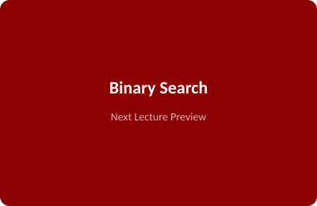
Binary Search – Algorithm
Prerequisite: The array must be sorted in ascending or descending order.
Principle: Compare key with the middle element and eliminate half the search space each step.
Algorithm: BINARY_SEARCH(A,n,key): lo=0,hi=n-1; while lo<=hi: mid=(lo+hi)/2; if A[mid]==key: return mid; elif A[mid]<key: lo=mid+1; else: hi=mid-1; return -1
Time: O(log2 n) — halves search space at every step.
Space: O(1) iterative; O(log n) recursive (call stack overhead).

Slide 4
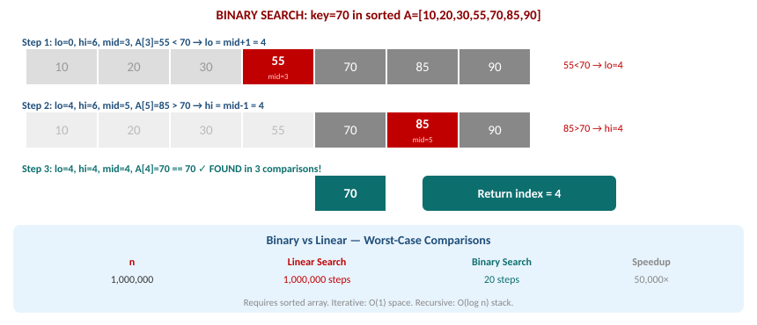
Binary Search – Step-by-Step Trace & Comparison

Slide 5
Summary of the Lecture
Binary search requires a sorted array and eliminates half the elements per comparison.
Best case: O(1) — key is the middle element. Worst and average: O(log2 n).
For n=1,000,000: binary search takes only 20 steps vs linear search's 1,000,000.
Iterative binary search uses O(1) space; recursive version uses O(log n) stack space.
Binary search underpins lower_bound, sorted sets, and many advanced algorithms.

Slide 6

Next Lecture
Chapter 1.2 – Introduction to Linked Lists: singly linked list structure, traversal, and operations.

Slide 7
Quiz/ FAQ's
Q1. Trace binary search on A=[2,5,8,12,16,23,38,56,72,91] for key=23. Count steps.
Q2. Derive O(log n) complexity for binary search from first principles.
Q3. Compare iterative and recursive binary search for time and space complexity.

Slide 8
References/ Articles
Cormen et al., Introduction to Algorithms (CLRS), 3rd Ed., MIT Press.
GeeksforGeeks – Binary Search: https://www.geeksforgeeks.org/binary-search/
Visualgo – Binary Search: https://visualgo.net/en/bst

Slide 9
Thank You
For queries
Email: abhishek.e19789@cumail.in

